Slide 1


XGBoost Regressor
Jayashree M

Slide 2
What is XGBoost Regressor?
XGBoost = Extreme Gradient Boosting
A powerful machine-learning algorithm
Used to predict numerical values (regression tasks)
Very fast and works well even on large datasets
Often more accurate than traditional models

Slide 3
Why is XGBoost Powerful?
Uses boosting → many small trees work together
Each new tree learns from previous mistakes
Handles missing data automatically
Built-in control to avoid overfitting
Uses parallel processing → very fast

Slide 4
How XGBoost Works
Starts with a simple prediction
Builds a small tree to fix errors
Adds more trees, each improving the result
Final prediction = combined output of all trees
Easy idea: Like a team where each member improves the previous one.

Slide 5
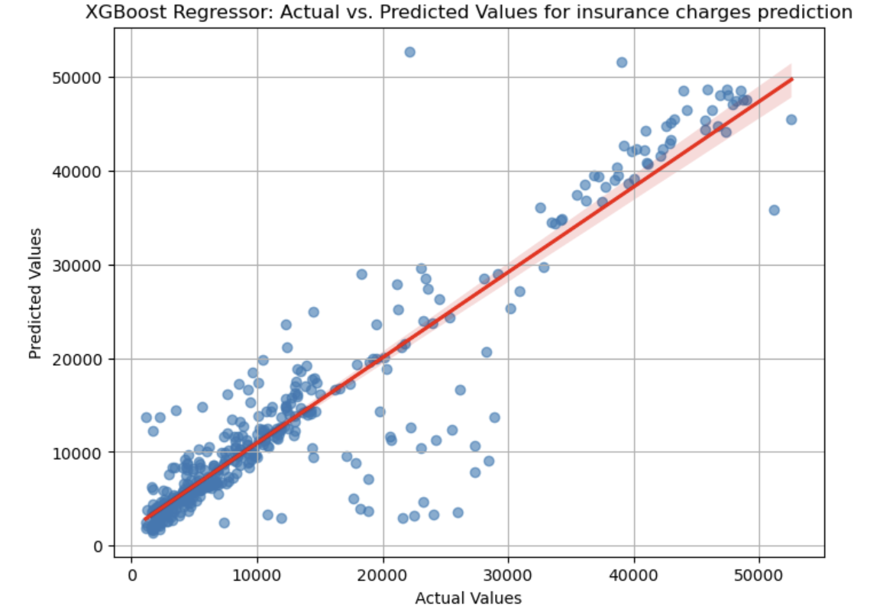
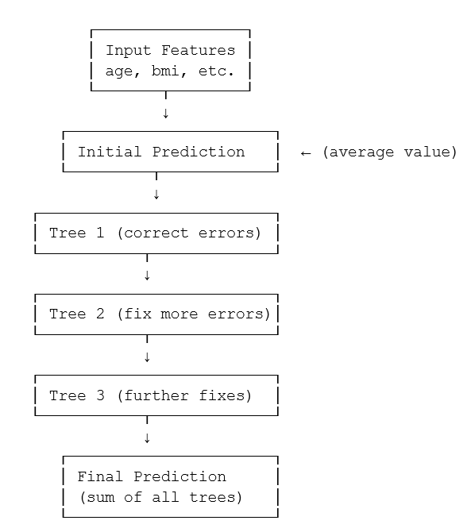
Example: Insurance Charges Prediction

Slide 6
Thank You

